Slide 1
SCIENCE FAIR NEWSLETTER
Here is where your presentation begins

Slide 2

TABLE OF CONTENTS
01
02
03
ANNOUNCEMENTS
IN DEPTH
IN BRIEF
04
05
WELCOME!
EVENTS
Here you could describe the topic of the section
Here you could describe the topic of the section
Here you could describe the topic of the section
Here you could describe the topic of the section
Here you could describe the topic of the section

Slide 3
01
ANNOUNCEMENTS
You could enter a subtitle here if you need it

Slide 4
1st ANNOUNCEMENT
Mercury is the closest planet to the Sun and the smallest one in our Solar System—it’s only a bit larger than our Moon

Slide 5
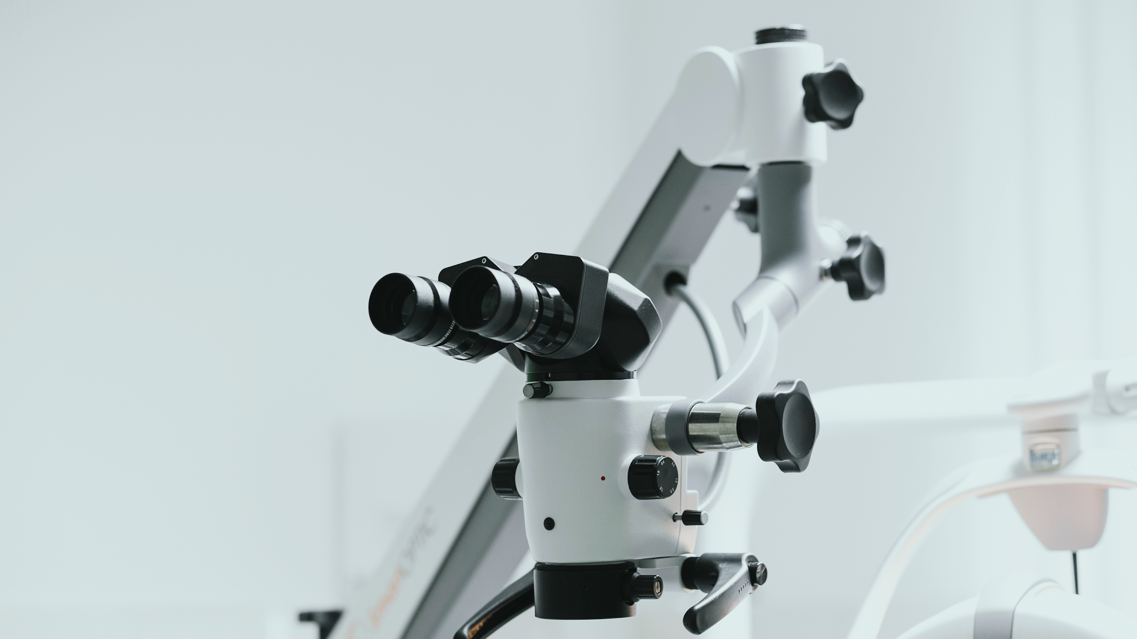
A PICTURE IS WORTH A THOUSAND WORDS

Slide 6
HIGHLIGHTS OF THE MONTH
MARS
02
SATURN
01
VENUS
03
Despite being red, Mars is actually a cold place. It’s full of iron oxide dust
Saturn is the ringed planet. It’s composed mostly of hydrogen and helium
Venus has a beautiful name and is the second planet from the Sun

Slide 7
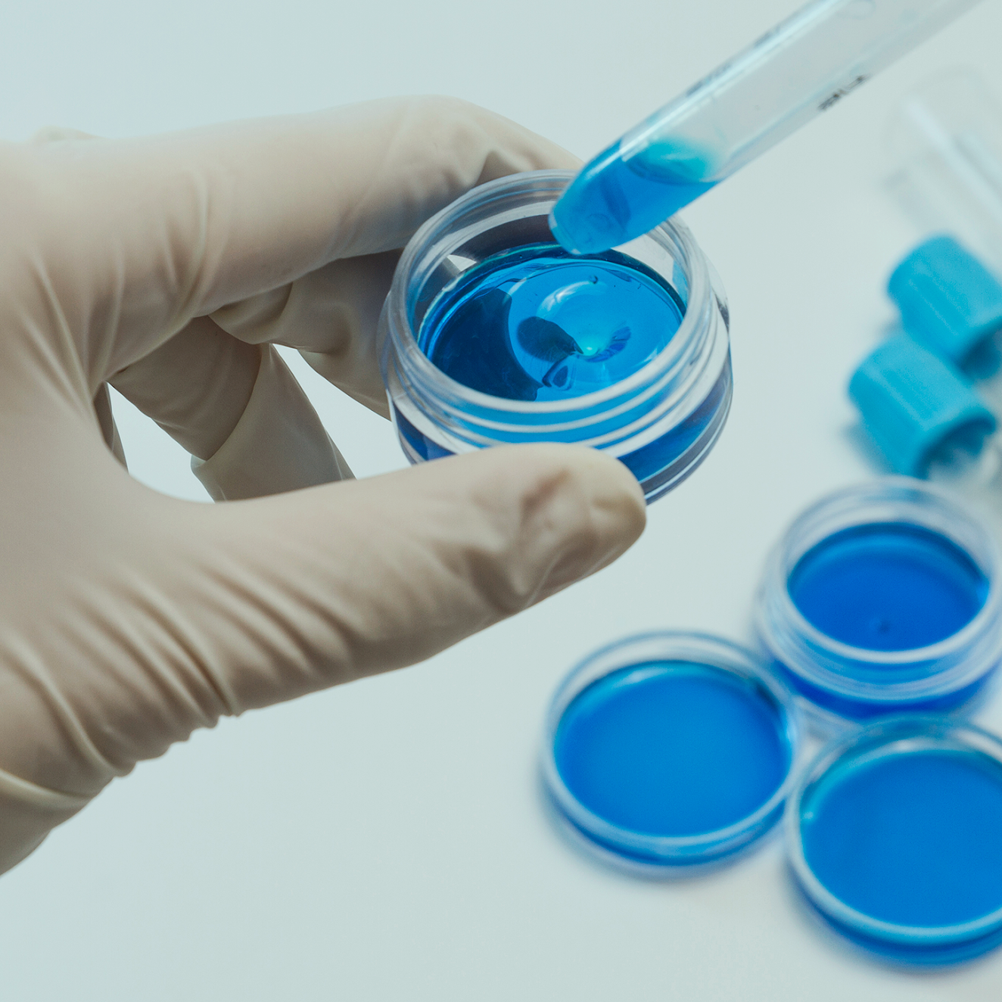
A PICTURE ALWAYS REINFORCES THE CONCEPT
Images reveal large amounts of data, so remember: use an image instead of long texts

Slide 8

IN DEPTH
02
You could enter a subtitle here if you need it

Slide 9

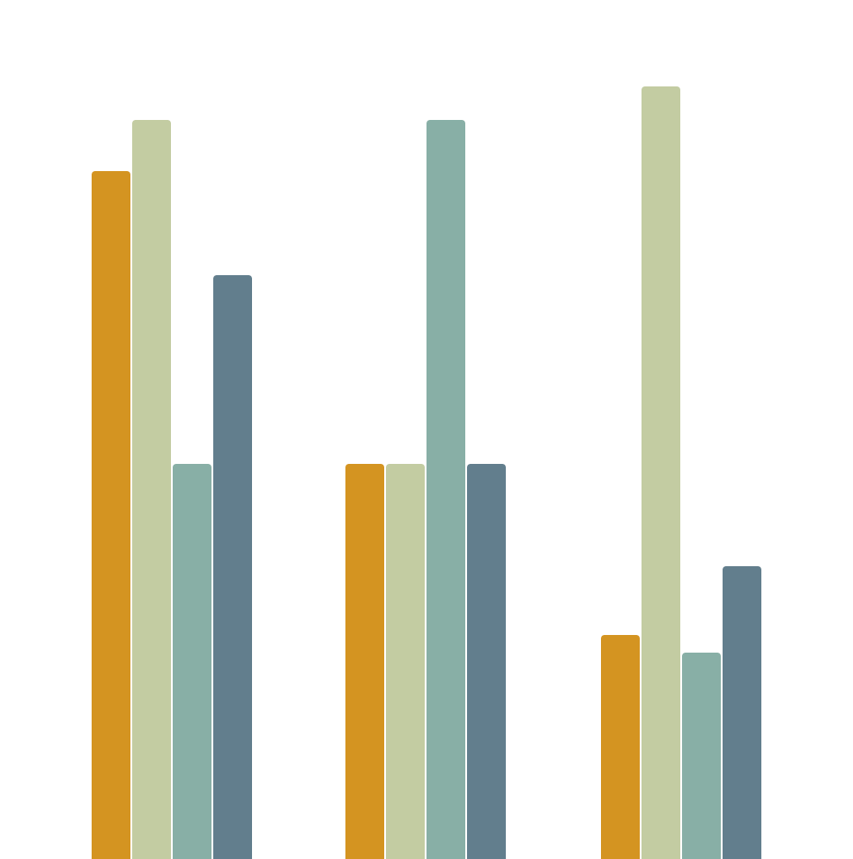
IN DEPTH
MERCURY
MARS
VENUS
NEPTUNE
Mercury is the closest planet to the Sun
Despite being red, Mars is actually a cold place
Venus has a beautiful name, but it’s terribly hot
Neptune is the farthest planet from the Sun
2013
2015
2018

Slide 10

SECTOR NEWS
VENUS
MERCURY
MARS
NEPTUNE
SATURN
JUPITER
Venus has a beautiful name, but it’s terribly hot
Mercury is the closest planet to the Sun
Despite being red, Mars is actually a cold place
Neptune is the farthest planet from the Sun
Saturn is the ringed one and a gas giant
It’s the biggest planet in our Solar System

Slide 11
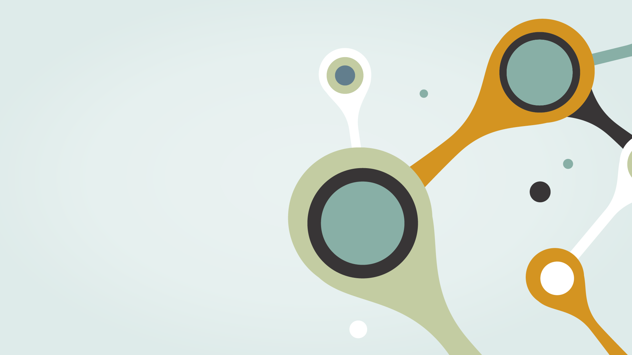
IN BRIEF
03
You could enter a subtitle here if you need it

Slide 12
OUR NUMBERS
 | MASS (EARTHS) | GRAVITY (EARTHS) | DIAMETER (EARTHS)
MARS | 100 | 355 | 370
MERCURY | 490 | 150 | 890
VENUS | 1,000 | 260 | 245

Slide 13
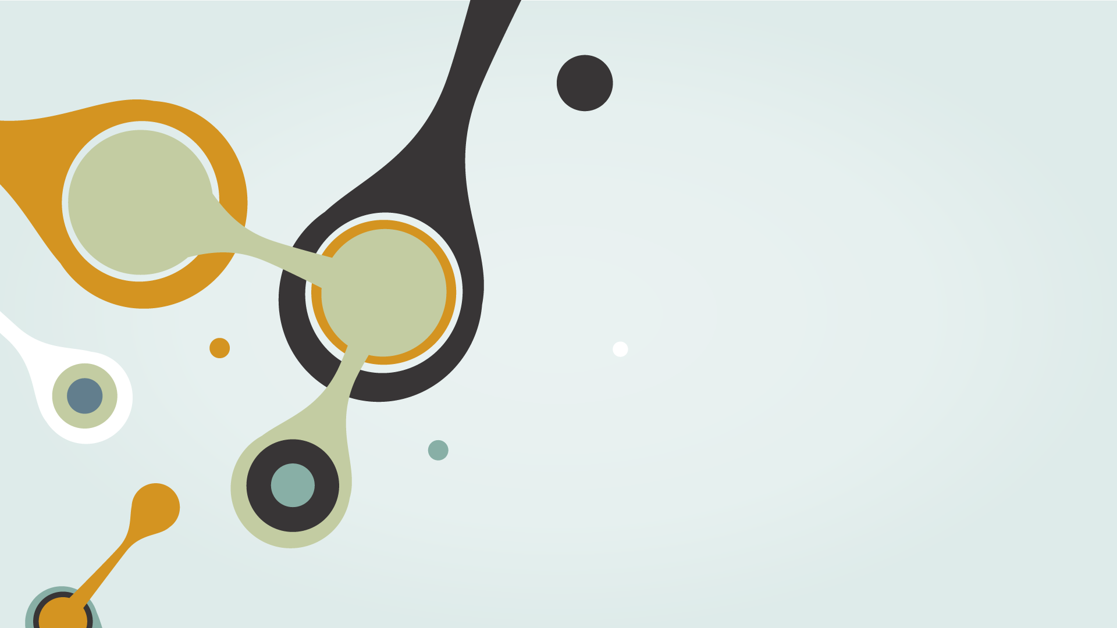
04
WELCOME
You could enter a subtitle here if you need it

Slide 14

05
EVENTS
You could enter a subtitle here if you need it

Slide 15
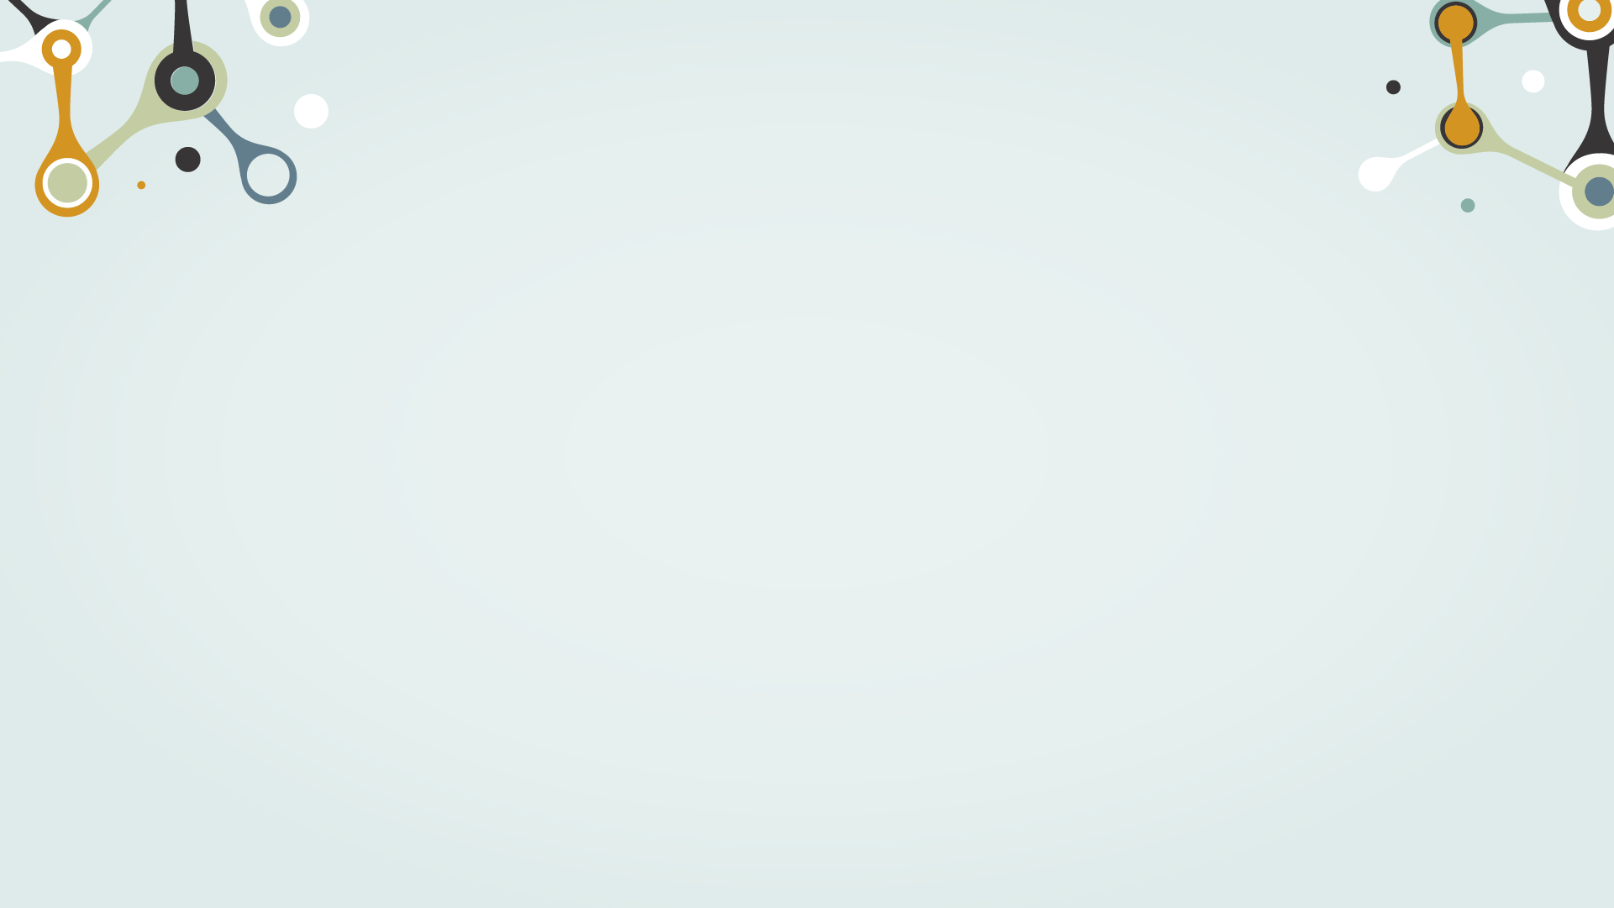
IN BRIEF
This is an item on your list
This is an item on your list
This is an item on your list
This is an item on your list
This is an item on your list
This is an item on your list
This is an item on your list
This is an item on your list

Slide 16
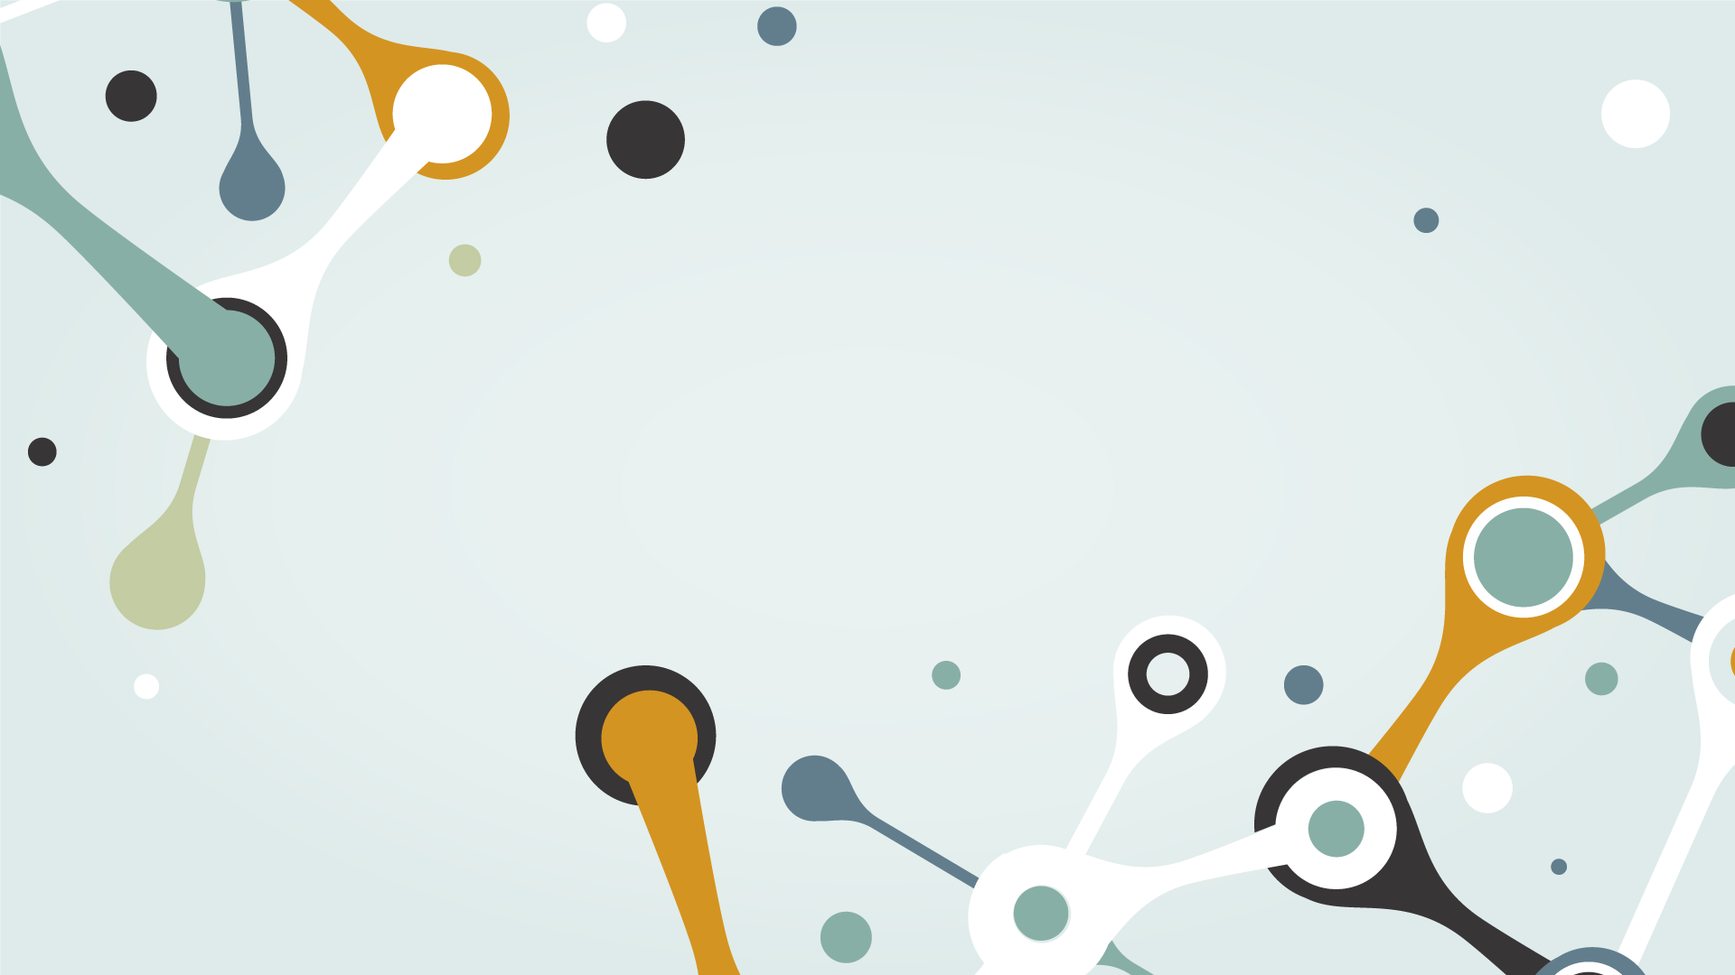
THANK YOU

Slide 17
REVIEW OF PAST EVENTS
SATURN
NEPTUNE
01
02
03
04
05
JUPITER
MERCURY
VENUS
Saturn is the ringed one and a gas giant
It’s the farthest planet from the Sun
It’s the biggest planet of them all
Mercury is the closest planet to the Sun
It’s the second planet from the Sun

Slide 18
UPCOMING EVENTS
MERCURY
VENUS
MARS
APRIL 12
MAY 04
JUNE 23
Mercury is the closest planet to the Sun
Venus is the second planet from the Sun
Despite being red, Mars is actually a cold place

Slide 19
ALTERNATIVE RESOURCES

Slide 20
Fonts & colors used
This presentation has been made using the following fonts:
Teko
(https://fonts.google.com/specimen/Teko)
Hind Vadodara
(https://fonts.google.com/specimen/Hind+Vadodara)
#e6f0ef
#d49421
#c3cca2
#88afa6
#627e8d

